Slide 1
MACHINE LEARNING COMPETITION REPORT
Spaceship Titanic:
Predicting Dimensional Transport with Ensemble Learning
Author: Mireille Ingabire
Published: September 11, 2026
Competition Platform: Kaggle — Spaceship Titanic
Final Leaderboard Accuracy: 80.944%

Slide 2
INTRODUCTION
Project Overview
The Spaceship Titanic competition poses a binary classification problem: predict whether each passenger aboard a spacecraft was transported to an alternate dimension following a collision with a spacetime anomaly. This project combines structured feature engineering, five independently trained base models, and two ensemble strategies — stacking and weighted voting — to maximize both cross-validated accuracy and leaderboard performance.
PROJECT TARGET
80.0%
ACHIEVED RESULT
80.944%
Approach: Feature engineering → five base models → ensemble comparison → final soft-voting model
Evaluation metric: Classification accuracy, validated using stratified five-fold cross-validation
Leaderboard accuracy — exceeding target by 0.944 percentage points
CROSS-VALIDATION ACCURACY
81.55%
Spaceship Titanic — Machine Learning Competition Report
2

Slide 3
DATA
Dataset Overview
8,693 × 14
4,277 × 13
8,693 × 24
42
Training Set
Test Set
Final Feature Matrix
Random Seed
rows × columns
rows × columns
after feature engineering
fixed for reproducibility
Key Data Characteristics
Target balance: 50.36% — classes are nearly evenly split, so accuracy is a fair evaluation metric.
Missing values: approximately 2% of entries in every column except Passenger Identifier and Transported.
Structured Cabin column: encoded as deck / cabin number / side, and unpacked into separate features.
Structured Passenger Identifier: encoded as group / position within group, and unpacked into separate features.
Spaceship Titanic — Machine Learning Competition Report
3

Slide 4
FEATURE ENGINEERING
Engineered Numeric Features
Seventeen engineered features were derived from the raw data; the thirteen numeric features below combine with six categorical features to form the final twenty-four-feature matrix.
DEMOGRAPHIC
GROUP STRUCTURE
Age: Passenger age (original field)
Group Length: Number of passengers traveling together
Solo Traveler Indicator: Flag for passengers traveling alone
SPENDING BEHAVIOR
Seat Position: Position within the travel group
Total Spending: Sum of all five service spending columns
Log-Transformed Spending: Logarithmic transform to correct skew
Cabin Room Number: Numeric room extracted from the cabin code
Zero-Spending Indicator: Flag for passengers with no recorded spending
INTERACTION TERM
Amenity Usage Count: Number of distinct services used
Cryogenic Sleep × Zero Spending: Captures passengers asleep with no spending
High-End Spending: Combined Spa, VR Deck, and Room Service spending
Low-End Spending: Combined Food Court and Shopping Mall spending
High-End Spending Ratio: Proportion of spending on premium services
Spaceship Titanic — Machine Learning Competition Report
4

Slide 5
FEATURE ENGINEERING
Categorical Features & Preprocessing Pipeline
CATEGORICAL FEATURES
PREPROCESSING PIPELINE
Home Planet
Cryogenic Sleep
Destination
Numeric Columns
Mean Imputation
(fill missing values)
→
Standard Scaling
(normalize range)
VIP Status
Cabin Zone
Cabin Pier
All preprocessing runs inside a single scikit-learn Pipeline object, preventing information leakage during cross-validation.
Categorical Columns
Most-Frequent Imputation
(fill missing values)
→
One-Hot Encoding
(unknown categories ignored)
Both transformed sets are combined by a Column Transformer before reaching the models.
Spaceship Titanic — Machine Learning Competition Report
5

Slide 6
MODELING
Base Models Tested
Five independent classification algorithms were trained and evaluated using stratified five-fold cross-validation before any ensembling was applied.
STRONGEST SINGLE MODEL
CatBoost
Gradient Boosted Decision Trees
0.8133
Cross-validation accuracy
Configuration: 400 boosting iterations, learning rate 0.06, tree depth 5.
Spaceship Titanic — Machine Learning Competition Report
6

Slide 7
MODELING
Ensemble Methods Compared
Stacking Ensemble
Weighted Voting Ensemble
BEST RESULT
All five base models feed a Logistic Regression meta-model, which learns how to combine their outputs.
Decision Tree, Extra Trees, CatBoost, and LightGBM combined through probability-weighted soft voting.
CROSS-VALIDATION
CROSS-VALIDATION
LEADERBOARD
0.8132
0.8155
0.80944
Stacking did not outperform the simpler weighted voting approach, suggesting the meta-model added complexity without additional predictive signal.
This ensemble outperformed every individual model and the stacking approach, and became the final submitted model.
Spaceship Titanic — Machine Learning Competition Report
7

Slide 8
FINAL MODEL
Final Model Architecture
The final submitted model is a four-algorithm soft-voting ensemble that averages predicted probabilities rather than taking a simple majority vote.
Decision Tree
Extra Trees
CatBoost
LightGBM
Simple baseline tree model
Diverse bagging ensemble
Strongest gradient boosting model
Fast, complementary gradient boosting model
Soft Voting (Probability Averaging)
Why this combination worked: two bagging models (Decision Tree, Extra Trees) and two boosting models (CatBoost, LightGBM) make different types of errors, so averaging their probabilities is more robust than any single algorithm or a hard majority vote.
Final Prediction
Spaceship Titanic — Machine Learning Competition Report
8

Slide 9
RESULTS
Final Model Ranking
Spaceship Titanic — Machine Learning Competition Report
9

Slide 10
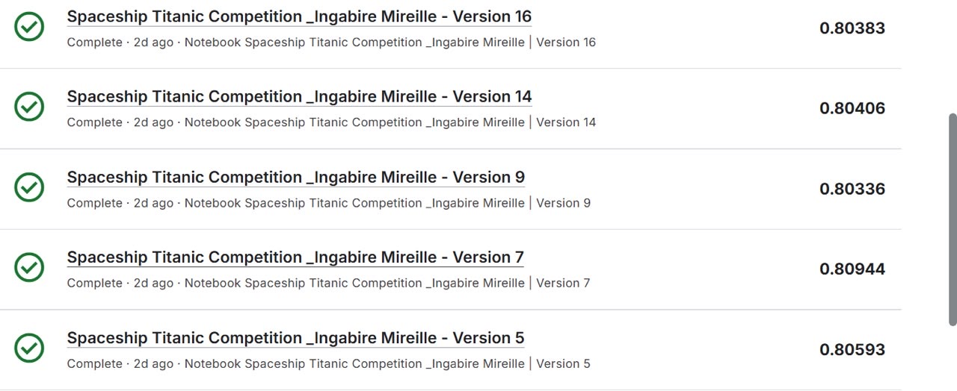
EVIDENCE
Kaggle Notebook Version History
Sixteen notebook versions were submitted over the course of the competition. Version 7 — the weighted voting ensemble with LightGBM — produced the best leaderboard score.
Version 7: 0.80944 — the best-scoring submission and the final selected model.
Spaceship Titanic — Machine Learning Competition Report
10

Slide 11
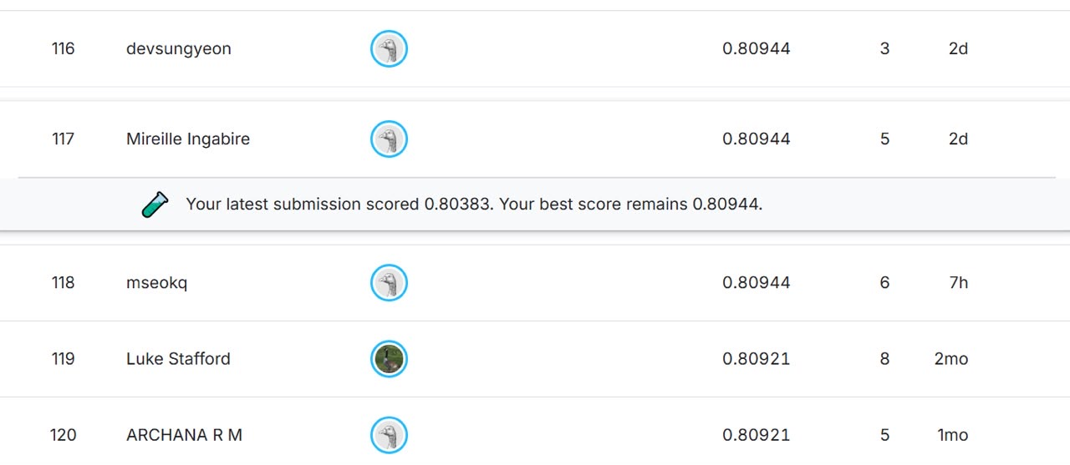
EVIDENCE
Kaggle Leaderboard Standing
The final submission placed at rank 117 on the public leaderboard, tied with several other competitors at a score of 0.80944.
Rank 117: Mireille Ingabire — public leaderboard score of 0.80944, five submissions.
Spaceship Titanic — Machine Learning Competition Report
11

Slide 12
RESULTS
Cross-Validation vs. Leaderboard Generalization
Comparing cross-validation accuracy against leaderboard accuracy reveals how well each model generalizes to unseen data.
Model | Cross-Validation Accuracy | Leaderboard Accuracy | Generalization Gap
Weighted Voting + LightGBM (final model) | 0.8155 | 0.80944 | +0.0061
CatBoost (single model) | 0.8133 | 0.80430 | +0.0090
KEY INSIGHT
The weighted voting ensemble shows a smaller generalization gap (+0.0061) than the single CatBoost model (+0.0090). A smaller gap between cross-validation and leaderboard accuracy indicates the ensemble generalizes more reliably to data it has not seen, which is why it was selected as the final submission.
Spaceship Titanic — Machine Learning Competition Report
12

Slide 13
SUBMISSION
Submission Summary
File name: submission.csv
Shape: 4,277 rows × 2 columns
Columns: Passenger Identifier, Transported
Missing values: 0
Duplicate rows: 0
The predicted class split closely mirrors the near-even balance observed in the training data, indicating the model has not introduced systematic bias toward either outcome.
Spaceship Titanic — Machine Learning Competition Report
13

Slide 14
REFLECTION
Challenges & Key Findings
CHALLENGES ENCOUNTERED
KEY FINDINGS
Missing values: About 2% of each column was missing; resolved with mean and mode imputation inside the pipeline.
Diverse ensembles outperform single models: Ensemble accuracy 0.8155 exceeded the CatBoost single-model accuracy of 0.8133.
Structured text fields: The Cabin field packed three facts into one string, requiring careful unpacking.
Soft voting outperforms hard majority voting: The weighted voting ensemble outperformed all individual models.
Shared group outcomes: Passengers traveling together often share outcomes; captured via group-length and solo-traveler features.
Stacking did not beat weighted voting: Stacking scored 0.8132 versus 0.8155 for weighted voting.
Feature count balance: Adding excess weak features reduced cross-validation accuracy; only the strongest features were retained.
Feature engineering mattered: Twenty-four engineered features outperformed the raw feature set.
Overfitting risk: Deeper trees and more estimators did not always help; regularization was necessary.
The ensemble generalized best: Its cross-validation-to-leaderboard gap of +0.0061 was the smallest observed.
Spaceship Titanic — Machine Learning Competition Report
14

Slide 15
CONCLUSION
A Four-Model Ensemble That Exceeded Target
This project produced a four-model soft-voting ensemble achieving a leaderboard accuracy of 80.944%, exceeding the project target of 80.0% by 0.944 percentage points.
FINAL LEADERBOARD SCORE
80.944%
1
Feature Engineering
Transformed fourteen raw columns into twenty-four informative features.
2
Model Diversity
Combining two bagging models with two boosting models reduced overall prediction error.
Cross-validation accuracy:
0.8155
Project target:
0.80
Margin above target:
+0.00944
3
Ensemble Strategy
Soft voting outperformed stacking, and adding LightGBM improved the final result.
Notebook: Spaceship Titanic Competition — Ingabire Mireille | Kaggle Competitions

